Slide 1


Introduction to BTS
BTS, also known as Bangtan Sonyeondan, is a seven-member South Korean boy band formed by Big Hit Entertainment. The group debuted on June 13, 2013, with the single "No More Dream" from their debut album, "2 Cool 4 Skool."
Ta
by Tarannum khatun

Slide 2
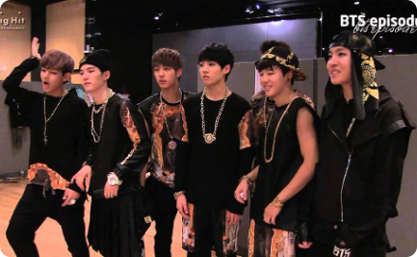


Formation and Early Years
Formation
Struggles
Hard Work
BTS was formed by Big Hit Entertainment through auditions in 2010 and 2011.
During their early years, BTS faced financial difficulties and critics' skepticism.
The members underwent intensive training, often practicing late into the night, to hone their skills.

Slide 3

Rise to Global Fame
1
Breakthrough
BTS gained international attention with their "The Most Beautiful Moment in Life" series.
2
Billboard Charts
The group's album, "Love Yourself: Answer," topped the Billboard 200 chart.
3
Tours and Awards
BTS embarked on world tours and received numerous awards, solidifying their global presence.

Slide 4

Musical Style and Influences
1
Diverse Genres
2
Lyrics and Messages
3
Influences
BTS' discography features a wide range of genres, including hip-hop, R&B, and EDM.
BTS cite artists like Nas, Eminem, and Epik High as major influences on their music.
Their songs often explore social issues, mental health, and the journey of self-discovery.

Slide 5




Discography and Achievements
Albums
Accolades
Chart-Toppers
Global Impact
BTS has released several studio albums, including "Map of the Soul: 7" and "BE".
They have won numerous awards, including multiple Billboard Music Awards and MTV Europe Music Awards.
Many of their songs have achieved top positions on various music charts.
BTS' music has made a significant cultural impact worldwide.

Slide 6
Impact on Popular Culture
Social Media
Fashion
Entertainment
BTS holds significant influence on social media platforms, engaging with millions of followers.
Their unique style and fashion choices have made an impact on global trends.
BTS' involvement in television and film has contributed to their influence in popular culture.

Slide 7



Philanthropy and Activism
UN Speech
Charitable Works
Social Initiatives
BTS delivered a powerful speech at the United Nations General Assembly, promoting self-love and kindness.
The band has made significant donations to various social and humanitarian causes.
BTS actively supports campaigns in mental health awareness and youth empowerment.

Slide 8
Conclusion and Future Plans
Insights
Future Plans
BTS' journey provides insights into perseverance, creative expression, and global connectivity.
The band aims to continue creating meaningful music and engaging with diverse global audiences.

Slide 9

Aword
This is the end of the presentation about BTS. Thank you for taking the time to learn about this remarkable group!

